Slide 1
Unit 2 Measuring
Notes:
This video covers measuring using a standard 12” ruler

Slide 2
Using a Ruler
0” to 12”
Read from left to right
Each inch unit has 16 lines, indicating fractions of an inch
Divided into
halves (1/2”)
quarters (1/4”, 3/4”)
eighths (1/8”, 3/8”, 5/8”,7/8”)
sixteenths (1/16”, 3/16”, 5/16”, 7/16”, 9/16”, 11/16”, 13/16”, 15/16”)
Notes:
Each inch unit is divided into fractions
Each fraction is indicated with a line
Four different lengths of lines within each inch
Longest is half inch mark
Next is quarter inch mark
Then eight inch mark
Smallest is sixteenth inch mark

Slide 3
Using a Ruler – 1” mark

Slide 4
Using a Ruler – 1/16” mark
Notes:
Notice the fraction conversion
We wouldn’t say 2/16”, we would say 1/8”
This graphic is the measuring-cheatsheet.pdf to refer to while becoming familiar with the fractions of an inch

Slide 5
Using a Ruler – ½” mark
Notes:
Longest line in between full inches is the ½ inch mark

Slide 6
Using a Ruler – 1/4” mark
Notes:
Notice the fraction 2/4. We would call that ½”

Slide 7
Using a Ruler – 1/8” mark
Notes:
Notice the 2/8” fraction. We would call that ¼”. The 4/8” fraction would be ½”. The 6/8” fraction would be ¾”

Slide 8
Using a Ruler – 1/16” mark
Notes:
We wouldn’t say 2/16”, we would say 1/8”

Slide 9
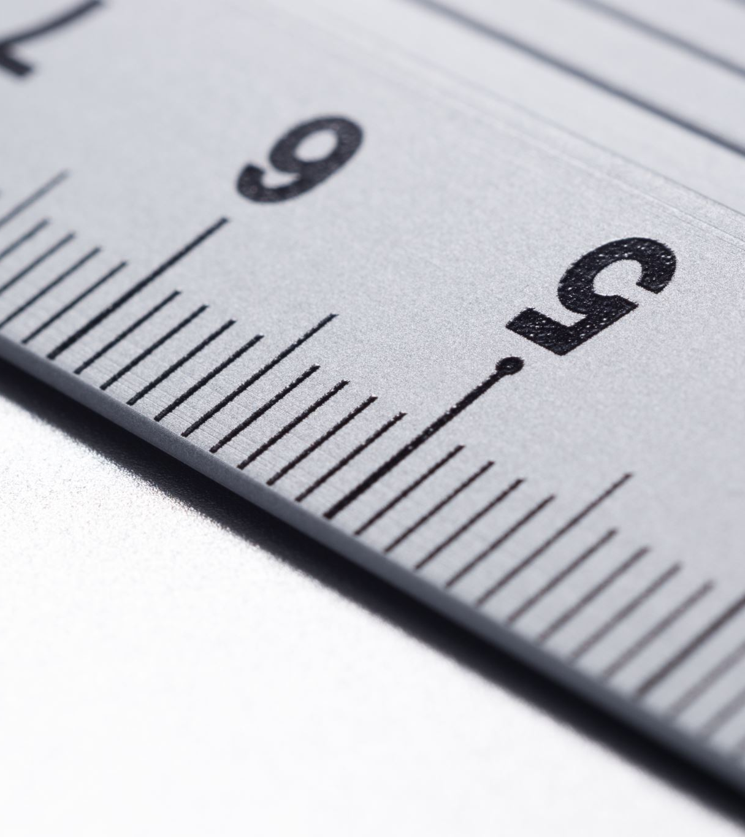
Writing measurements
Examples of measurements
¾”
1”
2 1/2”
Feet, Inches and Fractions
2’-0”
1’- 1/2”
3’- 4 ½”

Slide 10
Practice Together
Notes:
Print the measuring formative exercise.pdf for each student

Slide 11
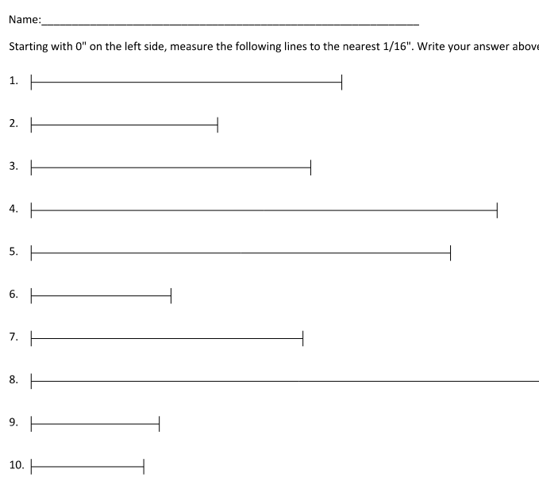
Worksheet overview
Students will need :
Printed worksheet
Standard 12” ruler
Writing utensil
Notes:
Print the measuring worksheet.pdf for each student
May want to print measuring - cheatsheet.pdf, cut into 4 smaller images, one for each student to use while becoming familiar

Slide 12
Apply it!
Print the “worksheet-Measuring.pdf” to practice measuring a few lines
Practice measuring objects around the classroom
Then visit rulergame.net to play!
Notes:
Print the measuring worksheet.pdf for each student
May want to print measuring cheatsheet.pdf, cut into 4 smaller images, one for each student to use while becoming familiar

Slide 13
Resources
All images from https://www.wikihow.com/Read-a-Ruler
https://creativecommons.org/licenses/by-nc-sa/3.0/

